Slide 1
Dynamic Programming Part 1
Xu Yanyan

Slide 2
Sharing repeated subproblems
For some problems, the branched recursion may end up evaluating the same sub-problem many times over. In such cases it may be worth saving the solutions to these overlapping subproblems, a technique commonly known as memoization. Followed to the limit, it leads to bottom-up divide-and-conquer algorithms such as dynamic programming.

Slide 3

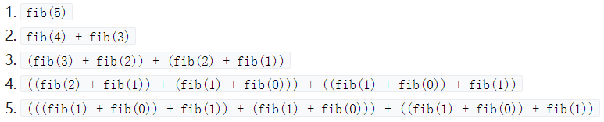
An simple example--Fibonacci sequence
a naïve implementation
overlapping subproblems, an exponential time algorithm O(2^{n})

Slide 4
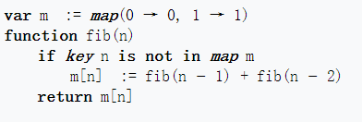
Top-down approach
Suppose we have a simple map object, m, which maps each value of fib that has already been calculated to its result, and we modify our function to use it and update it. The resulting function requires only O(n) time instead of exponential time (but requires O(n) space).
This technique of saving values that have already been calculated is called memorization.

Slide 5
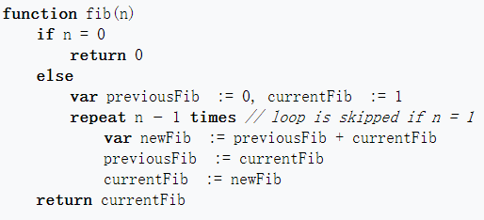
Bottom-up approach
In the bottom-up approach, we calculate the smaller values of fib first, then build larger values from them. This method also uses O(n) time since it contains a loop that repeats n − 1 times, but it only takes constant (O(1)) space, in contrast to the top-down approach which requires O(n) space to store the map.

Slide 6
Overlapping subproblems
Overlapping subproblems means that the space of subproblems must be small, that is, any recursive algorithm solving the problem should solve the same subproblems over and over, rather than generating new subproblems.
For example, consider the recursive formulation for generating the Fibonacci series: F_{i} = F_{i−1} + F_{i−2}, with base case F₁ = F₂ = 1. Then F₄₃ = F₄₂ + F₄₁, and F₄₂ = F₄₁ + F₄₀. Now F₄₁ is being solved in the recursive subtrees of both F₄₃ as well as F₄₂. Even though the total number of subproblems is actually small (only 43 of them), we end up solving the same problems over and over if we adopt a naive recursive solution. Dynamic programming takes account of this fact and solves each sub-problem only once.

Slide 7
Optimal substructure
In computer science, if a problem can be solved optimally by breaking it into sub-problems and then recursively finding the optimal solutions to the sub-problems, then it is said to have optimal substructure.
For example, given a graph G=(V,E), the shortest path p from a vertex u to a vertex v exhibits optimal substructure: take any intermediate vertex w on this shortest path p. If p is truly the shortest path, then it can be split into sub-paths p1 from u to w and p2 from w to v such that these, in turn, are indeed the shortest paths between the corresponding vertices. Hence, one can easily formulate the solution for finding shortest paths in a recursive manner.

Slide 8
DP && D&C
There are two key attributes that a problem must have in order for dynamic programming (DP) to be applicable: optimal substructure and overlapping sub-problems.
If a problem can be solved by combining optimal solutions to non-overlapping sub-problems, the strategy is called "divide and conquer (D&C)" instead.

Slide 9
Solve each sub-problem only once
Top-down approach: This is the direct fall-out of the recursive formulation of any problem. If the solution to any problem can be formulated recursively using the solution to its subproblems, and if its subproblems are overlapping, then one can easily memorize or store the solutions to the subproblems in a table. Whenever we attempt to solve a new subproblem, we first check the table to see if it is already solved. If a solution has been recorded, we can use it directly, otherwise we solve the subproblem and add its solution to the table.

Slide 10
Bottom-up approach: Once we formulate the solution to a problem recursively as in terms of its subproblems, we can try reformulating the problem in a bottom-up fashion: try solving the subproblems first and use their solutions to build-on and arrive at solutions to bigger subproblems. This is also usually done in a tabular form by iteratively generating solutions to bigger and bigger subproblems by using the solutions to small subproblems. For example, if we already know the values of F₄₁ and F₄₀, we can directly calculate the value of F₄₂.

Slide 11
Examples
The number triangle problem
Dynamic programming on DAG
Stacking Boxes
A Coin Problem
A Spy in the Metro
Multi-stage decision problems
Unidirectional TSP
0-1 knapsack problem
Dynamic programming on linear structure
The longest common subsequence problem
The longest increasing subsequence problem

Slide 12
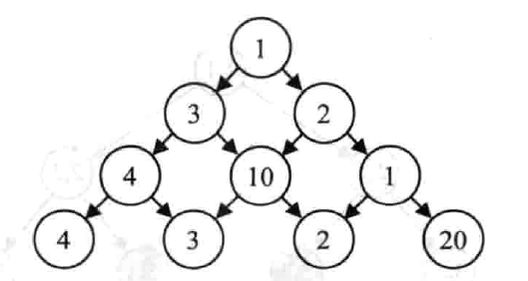
The number triangle problem
The figure below shows a number triangle. Write a program that calculates the maximum sum of numbers passed on a route that starts at the top and ends somewhere on the base. Each step can go either diagonally down to the left or diagonally down to the right.
2³⁰= 1024³ > 10⁹=1billion

Slide 13
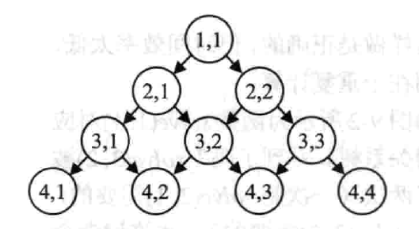
State & Solution
Consider the position (i, j) as a state, and then define the function d(i, j) as the maximum sum that can be obtained starting from (i, j) (including (i,j) itself).
Then, the solution of the problem is d(1,1).

Slide 14
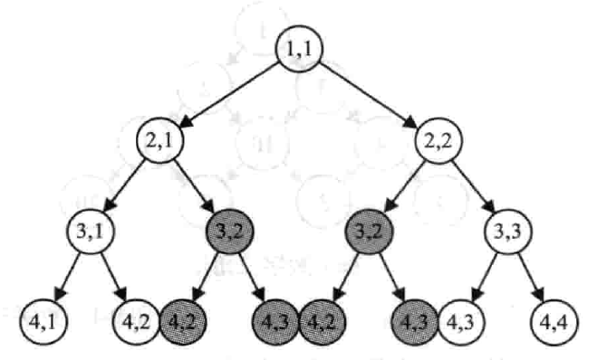
Brute force
int solve(int i, int j){
return a[i][j] + (i == n ? 0 : max(solve(i + 1, j), solve(i + 1, j + 1)));
}
2³⁰= 1024³ > 10⁹=1billion
Overlapping subproblems

Slide 15
Dynamic Programming ?
Overlapping subproblems √
Optimal substructure √

Slide 16
The core of dynamic programming is the “state transition equation”.

Slide 17
State transition equation
d(i,j) = a(i,j) + max{d(i+1,j),d(i+1,j+1)}

Slide 18
Memorization
If d(i,j) is saved after it is calculated, then it can be directly used next time, so that repeated calculations can be avoided.
O(n²) (the total number of states is n(n+1)/2)

Slide 19
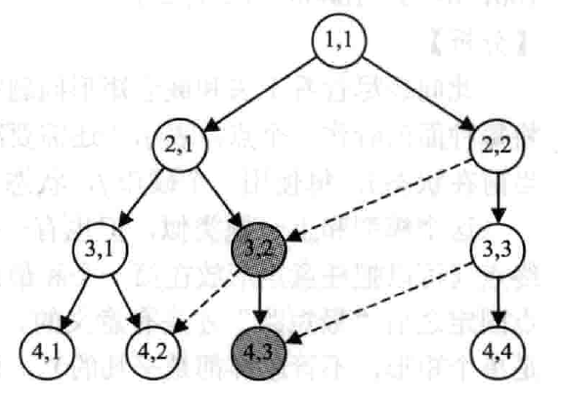
Top-down approach
First, memset(d,-1,sizeof(d))
Then, recursion
int solve(int i, int j){
if(d[i][j] >= 0) return d[i][j];
return d[i][j] = a[i][j] + (i == n ? 0 : max(solve(i + 1, j), solve(i + 1, j + 1)));
}
d(i,j) is computed only once. O(n²)
There is no need to determine the order of calculation of each state in advance (recursion is used, and it implies the order), but it is necessary to judge "whether it has been calculated" for each state.

Slide 20
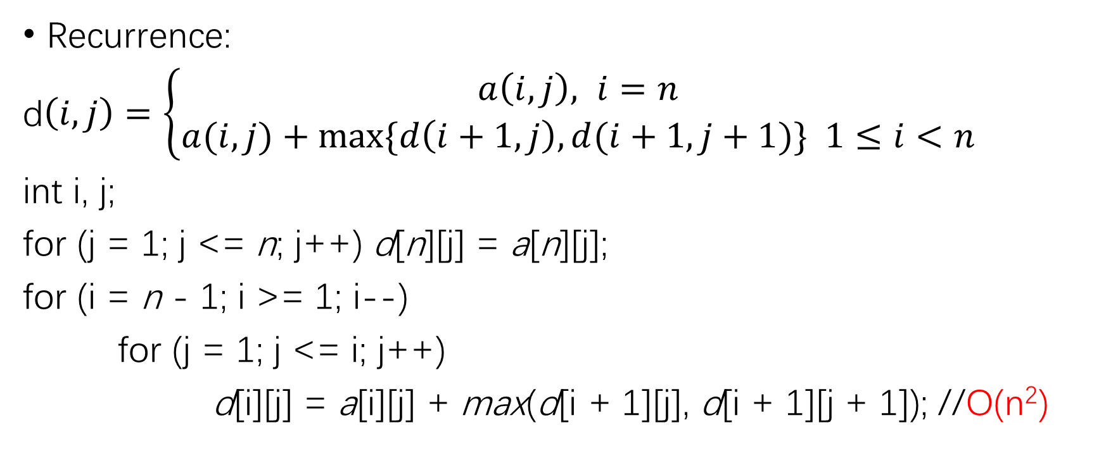
Bottom-up approach
Recurrence:
d$\left(i,j\right)=\left\{\begin{aligned}a\left(i,j\right), i=n \\ &a(i,j)+max⁡\{d\left(i+1,j\right),d(i+1,j+1)\} 1≤i<n\end{aligned}\right.$
int i, j;
for (j = 1; j <= n; j++) d[n][j] = a[n][j];
for (i = n - 1; i >= 1; i--)
for (j = 1; j <= i; j++)
d[i][j] = a[i][j] + max(d[i + 1][j], d[i + 1][j + 1]); //O(n²)

Slide 21
Top-down approach & Bottom-up approach
In practical applications, a bottom-up dynamic programming is usually better than a top-down memo approach by a constant factor, because the former does not require the cost of recursion.
In most cases, the time complexity = the number of states * the number of decisions at each state * the decision time

Slide 22
Dynamic programming & Optimization problems
Dynamic programming is usually applied to "optimization problems". There may be many optimal solutions for such problems, and we only need to find an optimal solution (maximum or minimum).

Slide 23
Four steps of dynamic programming
Describe the structure of the optimal solution. (State)
Recursively define the value of the optimal solution. (State transition equation) Top-down analysis
Calculate the value of the optimal solution in a bottom-up approach. Bottom-up computing
Construct an optimal solution (path) from the calculated result.
The first three steps constitute the basis of dynamic programming. Step 4 can be omitted when only the value of the optimal solution is required. If step 4 is required, it is sometimes necessary to record additional information in the calculation of step 3 to simplify step 4.

Slide 24

Exercise http://acm.hdu.edu.cn/showproblem.php?pid=1176

Slide 25
Dynamic programming on DAG
Dynamic programming on a directed acyclic graph is the basis for learning dynamic programming. Many problems can be transformed into the longest path, shortest path, or path counting problems on DAG.
Stacking Boxes
A Coin Problem
A Spy in the Metro (Uva1025)

Slide 26
Stacking Boxes
A box(2,3) represents a box with length 2 and width 3. The box X(a,b) nests in the box Y(c,d) if and only if a<c && b<d, or b<c && a<d. You are to determine the longest nesting string of boxes, that is a sequence of boxes b₁, b₂, . . . , b_{k} such that each box b_{i} nests in box b_{i+1} (1 ≤ i < k).
If there is more than one longest nesting string, you should output the lexicographically smallest one.
The longest path on a DAG

Slide 27
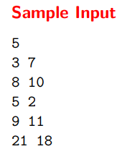
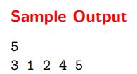
Input & Output
The input begins with a line consisting of the number of boxes n. This line is followed by n lines, one line per box, with x and y of each box.
Output the length of the longest nesting string on one line followed on the next line by a list of the boxes that comprise this string in order. The “smallest” or “innermost” box of the nesting string should be listed first, the next box (if there is one) should be listed second, etc.

Slide 28
state & state transition equation
Consider box i as a state, and then define the function d(i) as the length of the longest path starting from i.
d(i) = max{d(j)+1 | (i,j)∈E}
O(n²) (the number of states * the number of decisions at each state)

Slide 29
Top-down approach (Memorization)
int dp(int i) {
int& ans = d[i]; // to simplify the code
if(ans > 0) return ans;
ans = 1;
for(int j = 1; j <= n; j++)
if(G[i][j]) ans = max(ans, dp(j)+1);
return ans;
}

Slide 30
Output the lexicographically smallest solution
void print_ans(int i) {
printf("%d ", i);
for(int j = 1; j <= n; j++)
if(G[i][j] && d[i] == d[j]+1) {
print_ans(j);
break;
}
}

Slide 31
A Coin Problem
There are n kinds of coins with denominations of V₁, V₂,...,V_{n}, and there are unlimited numbers of each kind of coin. Given a non-negative integer S, calculate how many coins can be used so that the sum of their values is equal to S. Output the minimum and maximum number of coins. (1≤n≤100, 1≤S≤10000, 1≤V_{i} ≤S)

Slide 32
state & state transition equation
Regarding each value of money as a vertex, it means "how much more money is needed“. Then, the initial state is S, and the target state is 0. If it is currently at state i, every time a coin j is used, the state will transition to state i-V_{j}.
The function d(i) means the length of the longest or shortest path starting from i to 0.
d(i) = max{d(i – V[j]) + 1 | (i,V[j])∈E}
d(i) = min{d(i – V[j]) + 1 | (i,V[j])∈E};
maxv[i] = max(maxv[i], maxv[i – V[j]] + 1);
minv[i] = min(minv[i], minv[i – V[j]] + 1); O(S*n)

Slide 33
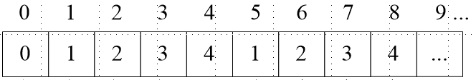
Example
int V[5] = {1, 5, 10, 25, 50}; //5 denominations
minv[i]

Slide 34
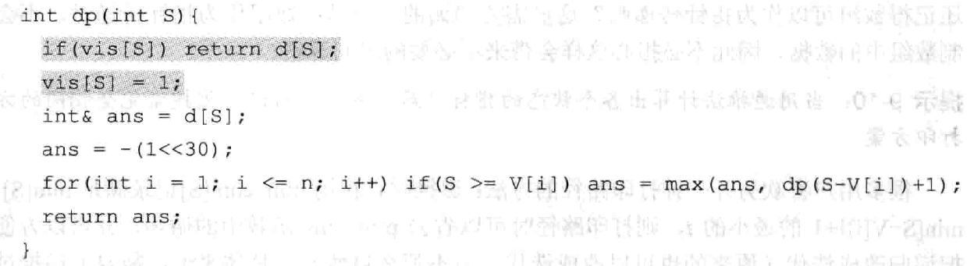
Top-down approach
// no path

Slide 35
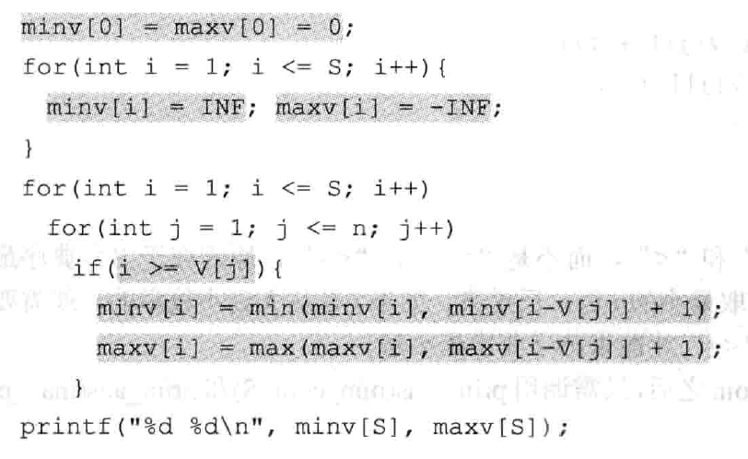
Bottom-up approach

Slide 36
Print the path (recursion)
void print_ans(int* d, int S) { //print_ans(min,S) or print_ans(max,S)
for(int i = 1; i <= n; i++)
if(S>=V[i] && d[S]==d[S-V[i]]+1) {
printf("%d ", i);
print_ans(d, S-V[i]);
break;
}
}

Slide 37
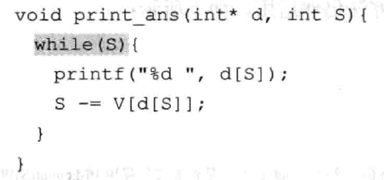
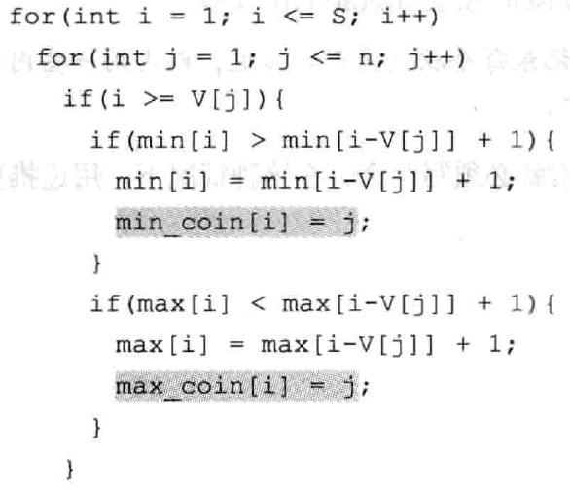
Print the path (iteration)
print_ans(min_coin,S) or print_ans(max_coin,S)
Trade space for time

Slide 38
A Spy in the Metro
O(n*T), n*T the number of states; the number of decisions at each state is 3

